Slide 1
CHIT CHAT CHATBOT A Sequence-to-Sequence model implementation using Star Wars conversations
Fengou Eleni
Koinakis michalis
Ntokou eleni

Slide 2
INTRODUCTION
Wide variety of use
Customer Support
Marketing
Productivity
Personal Assistants
Travel
E-Commerce
Finance & Legal
Leisure & Entertainment
Two main architectures
Rule Based Chatbots
As smart as they are programmed to be - respond only to predefined questions (If / Else Rules Chatbots).
Artificial Intelligence Chatbots
Process and understand natural language, getting smarter from conversations – they interact in a more human way.

Slide 3

Important Bot Developments
1950
The Turing Test
1966
Eliza
1972
Parry
1988
Jaberwa CKY
1995
A.L.I.C.E
2001
Smarterchild
2006
IBM Watson
2010
Siri
Google Now
2015
Cortana & Alexa
2016
Bots for messengers
2012

Slide 4

Chit Chat Mode of a Chatbot
Chit chat is the light conversation or simply put - small talk.
When users chat to a bot, they generally chat in two modes:
Functional: Try to complete a task – Get information or answer questions based on a topic.
Chatty: Testing out or exploring the chatbot – Involves typical conversational elements and off-topic questions.
It may seem insignificant, but chitchat helps chatbots be more memorable and engaging.
When the question is out of functional context, the chit chat mode engages.

Slide 5
General Project Approach
Gather all the dialogues from all Star Wars movies, all the Mandalorian series episodes, all The Clone Wars series episodes.
The final dataset consists of: 47047 sentences, 296605 tokens, 12261 unique tokens
Preprocess the data: Get the data from scripts and .srt subtitle files, fix contractions, remove symbols, keep dots, exclamation and question marks to denote the end of a sentence.
Create a big nested list with the dialogs. Issue here -> Most of the dialogues are not mapped or it is not possible to map them as conversations. Create groups of sentences in the range(2, 11) to get many different dialogue examples.
Create dictionaries with unique tokens IDs and token frequencies.
Deploy the Sequence-to-Sequence Recurrent Neural Network model with Gated Recurrent Unit (GRU) and Luong Attention Mechanism.
Train the model.
Evaluate the functionality by communicating and receiving the bot answers.

Slide 6
Architecture of a Chit Chat Bot – Seq2Seq Architecture
Two separate recurrent neural NETWORKS.
One RNN acts as an encoder, which encodes a variable length input sequence to a fixed-length context vector.
The second RNN is a decoder, which takes an input word and the context vector, and returns a guess for the next word in the sequence and a hidden state to use in the next iteration.
Attention
Vector (fixed length)
Encoder (RNN)
Decoder (RNN)
Input Reactant/product (unfixed length)
Output Product/reactant (unfixed length)

Slide 7
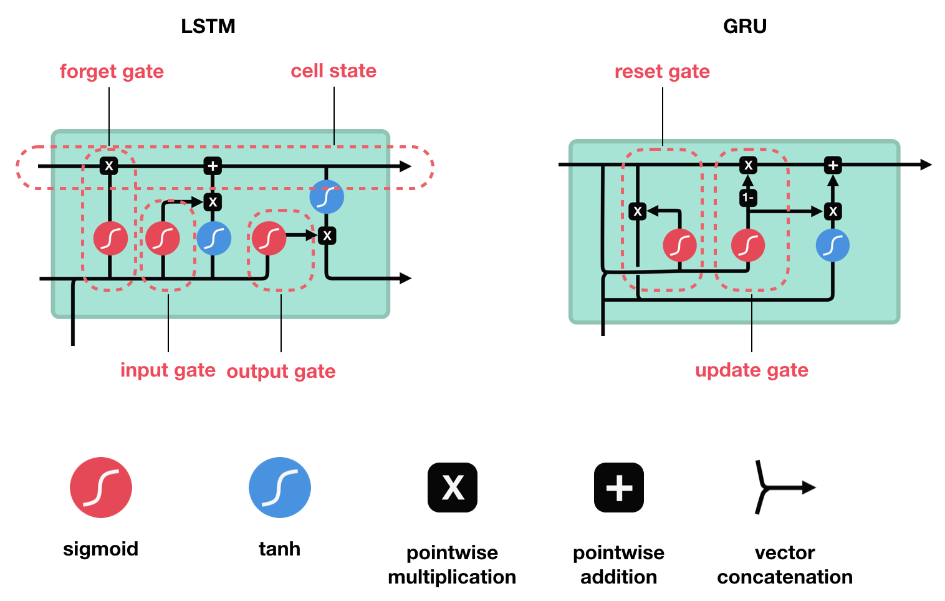
The Encoder
RNN iterates through the input sentence, one token at a time, at each time step outputting an “output” vector and a “hidden vector”.
The hidden vector is passed to the next time step, while the output vector is recorded.
The encoder transforms the context it saw at each point in the sequence into a set of points in a high-dimensional space, which the decoder will use to generate a meaningful output for the given task.
In the core of encoder lays a multi-layered GRU. This will give the advantage of encoding both past and future context.
An embedding layer is used to encode word indices in arbitrarily sized feature spaces. It maps each word to a feature space of size *hidden_size*.
A bidirectional variant of the GRU is fed the input sequence in normal sequential order, and one that is fed the input sequence in reverse order.
The outputs of each network are summed at each time step.

Slide 8
The Encoder Pipeline
Convert word indexes to embeddings
Pack padded batch of sequences for RNN module
Forward pass through GRU
Unpack padding
Sum bidirectional GRU outputs
Return output and final hidden state
Inputs
Input Sequence: Batch of input sentences of shape (max length, batch size)
Input Lengths: List of sentence lengths corresponding to each sentence in the batch of shape (batch size)
Hidden: Hidden state of shape (n_layers x num_directions , batch size, hidden size)
Outputs
Outputs: Output features from the last hidden layer of the GRU of shape (max length, batch size, hidden size)
Hidden: Updated hidden state from GRU (n_layers x num_directions , batch size, hidden size)

Slide 9
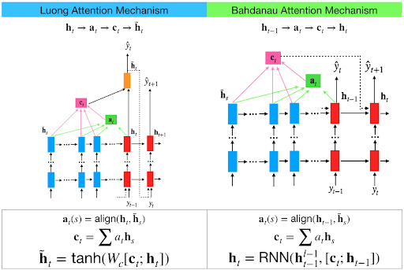
The Attention Layer Local Attention vs Global Attention
Decoder RNN generates the response sentence in a token-by-token fashion.
It uses encoder’s context vectors and internal hidden states to generate words until it outputs and End-of-String token representing the end of string (EOS).
Common problem when dealing with such decoders: They rely on solely context vector to encode the entire input sequence meaning.
With long input sequences, the decoder capabilities are limited.
Attention mechanisms were created (Bahdanau Local Attention), that allow the decoder to pay attention to certain parts of the input sequence, rather than using the entire fixed content at every step.
At a high level, attention is calculated using the decoder’s current hidden state and the encoder’s outputs. The output attention weights have the same shape as the input sequence, allowing to multiply them by the encoder outputs, giving a weighted sum which indicated the parts of encoder output to pay attention to.
Improvement to this, the Global Attention Mechanism (Luong Global Attention). It considers all of the encoder’s hidden states, ass opposed to Local Attention, which only considers the encoder’s hidden state of the decoder from the current time step only.
The output of the Global Attention Mechanism will be a softmax normalized weights tensor of shape (batch size, 1, max length).

Slide 10
The Decoder Pipeline
Get embedding of current input word
Forward through unidirectional GRU
Calculate attention weights from the current GRU output from previous step
Multiply attention weights to encoder outputs to get new “weighted sum” context vector
Concatenate weighted context vector and GRU output using Luong eq.
Predict next word using Luong eq.
Return output and final hidden state
Inputs
Input Step: One time step (one word) of input sequence batch of shape (1, batch size)
Last Hidden: Final hidden layer of GRU of shape (n_layers x num_directions, batch size, hidden size)
Encoder outputs: Encoder model’s output of shape (max length, batch size, hidden size)
Outputs
Output: Softmax normalized tensor giving probabilities of each word being the correct next word in the decoded sequence of shape (batch size, voc. num words)
Hidden: Final hidden state of GRU of shape (n_layers * num_directions, batch size, hidden size)

Slide 11
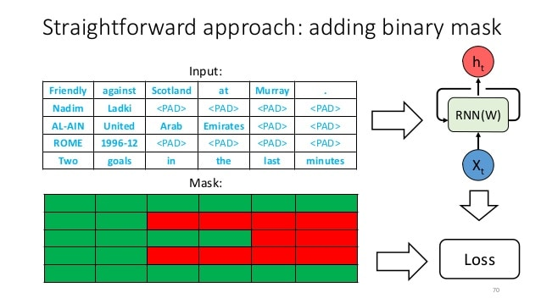
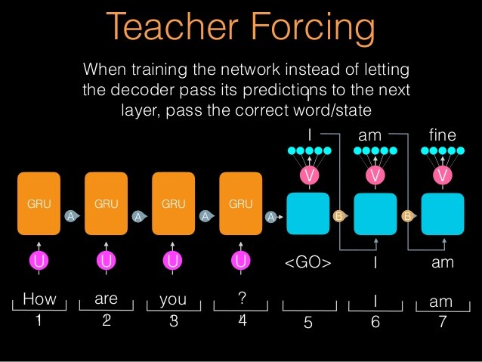
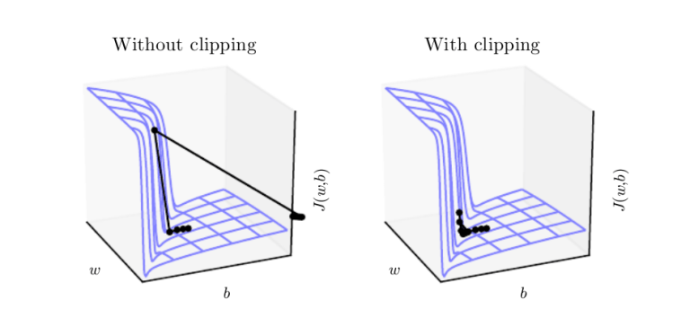
Training process
Define the Masked Loss to calculate the loss based on decoder’s outputs tensor, the target tensor, and a binary mask tensor describing the padding of the target tensor. It calculates the average negative log likelihood of the elements that correspond to a *1* in the mask tensor.
Use teacher forcing. At some probability set by the user, use the current target word as the decoder’s next input rather than using the decoder’s current guess. It aids in more efficient training – faster convergence. On the downside, can lead to model instability during inference, as the decoder may not have a sufficient chance to create its own output sequence during training.
Use gradient clipping. Thresholding gradients to a maximum value by preventing gradients from growing exponentially and either overflow or overshoot steep cliffs in the cost function.

Slide 12
Training Process Sequence of Operations
Forward pass entire input batch through encoder
Initialize decoder inputs as SOS_Token, and hidden state as the encoder’s final hidden state
Forward input batch sequence through decoder one time step at a time
If teacher forcing: set next decoder input as the current target; else: set next decoder input as current decoder output
Calculate and accumulate loss
Perform backpropagation
Clip gradients
Update encoder and decoder model parameters

Slide 13
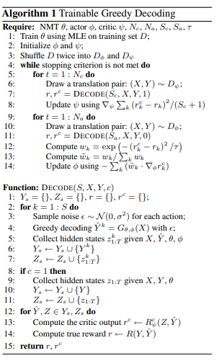
User Input Decoding The Greedy Search Decoder
Forward input through encoder model
Prepare encoder’s final hidden layer to be first hidden input to the decoder
Initialize decoder’s first input as SOS-Token
Initialize tensors to append decoded words to
Iteratively decode one word token at a time: a) Forward pass- through decoder b) Obtain most likely word token and its softmax score c) Record token and score d) Prepare current token to be next decoder input
Return collections of word tokens and scores
Greedy decoding – the decoding method when teacher forcing is not used. For each time step, choose the word from the decoder output with the highest softmax value. This method is optimal on a single time-step level.
Sequence of Operations

Slide 14
Evaluate User Input Sentence
This step of evaluation manages the low-level process of handling the input sentence.
First format the sentences as an input batch of word indexes with batch_size = 1 (convert the words of the sentences to their corresponding indexes and transpose the dimensions to prepare the tensor for models).
Create a lengths tensor which contains the length of the input sentence. This is scalar because it only evaluates one sentence at a time.
Obtain the decoded response sentence tensor from the Greedy Search Decoder.
Convert the response’s indexes to words and return the list of decoded words.

Slide 15
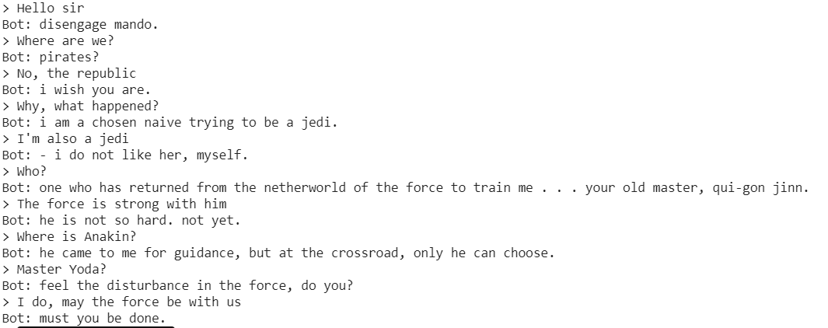
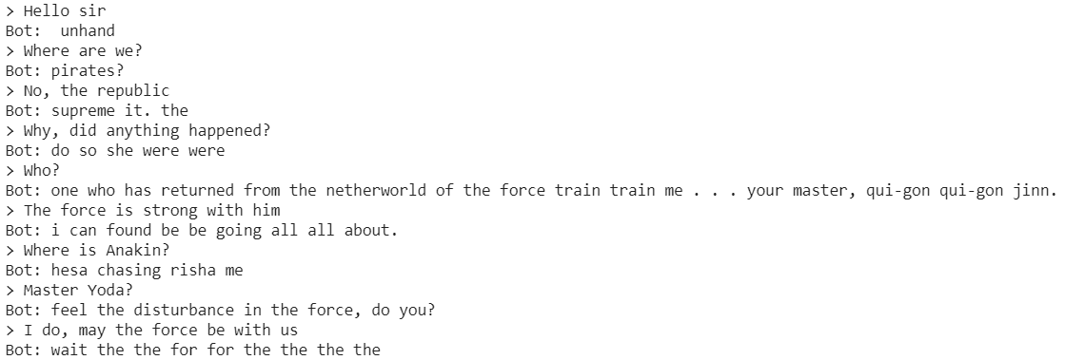
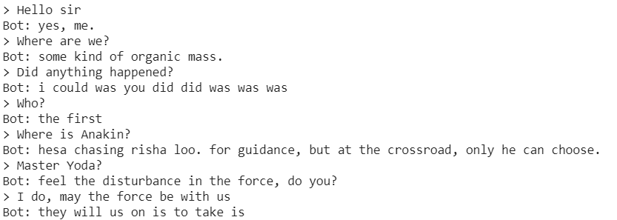
Chat Results
Concat Attention Layer
General Attention Layer
Dot Attention Layer

Slide 16
Project Recap & Future Work
The focus of the project was to receive responds as Master Yoda from the chatbot. This was not achieved since the dialogues of Master Yoda were few, and the model could not be trained.
The chatbot itself is not the smartest. Due to the main theme of the training data, it cannot respond as a normal human.
Due to computational restrictions and Google Colab time and resource restrictions, most of the tests were done with Luong Mechanism parameters and different models.
Although it can interact and chat with the end-user, it is not a standalone applications. In future work, it can be deployed along a FAQ about Star Wars or a Data Retrieval Bot. So, when the user chooses to provide (or of by mistake) an invalid input, the bot can respond in a Star Wars manner.

Slide 17
References
Knowledge Base, AI Powered (2020), Chit-chat in FAQ Bot
https://www.faqbot.ai/post/chit-chat-in-faq-bot
Pioneers.io, (2017), Tech On Trend – Chatbots
https://www.slideshare.net/Pioneers_io/tech-on-trend-chatbots
Sutskever Ilya, Vinyals Oriol, Le Quoc V., Sequence to Sequence Learning with Neural Networks, (14 December 2014)
https://arxiv.org/pdf/1409.3215.pdf
Cho Kyunghyun, Merrienboer Bart van, Gulcehre Caglar, Bougares Fethi, Schwenk Holger, Bahdanau Dzmitry, Bengio Yoshua, Learning Phrase Representations using RNN Encoder – Decoder for Statistical Machine Translation, (3 September 2014)
https://arxiv.org/pdf/1406.1078v3.pdf
Phi Michael, Illustrated Guide to LSTM’s and GRU’s: A step by step explanation, (24 September 2018), towardsdatascience.com
https://towardsdatascience.com/illustrated-guide-to-lstms-and-gru-s-a-step-by-step-explanation-44e9eb85bf21
Bahdanau Dzmitry, Cho KyungHyun, Bengio Yoshua, Neural Machine Translation by Jointly Learning to Align and Translate, (19 May 2016)
https://arxiv.org/pdf/1409.0473.pdf
Luong Minh-Thang, Pham Hieu, Manning Christopher D., Effective Approaches to Attention-based Neural Machine Translation, (20 September 2015), Computer Science Department, Stanford University, Stanford, CA
https://arxiv.org/pdf/1508.04025.pdf
Wood Thomas, Softmax Function, deepai.org
https://deepai.org/machine-learning-glossary-and-terms/softmax-layer
Brownlee Jason, What is Teacher Forcing for Recurrent Neural Networks, (6 December 2017), machinglearningmastery.com
https://machinelearningmastery.com/teacher-forcing-for-recurrent-neural-networks/
Bajaj Aayush, Understanding Gradient Clipping (and How It Can Fix Exploding Gradients Problem), neptune.ai
https://neptune.ai/blog/understanding-gradient-clipping-and-how-it-can-fix-exploding-gradients-problem
Gu Jiatao, Cho Kyunghyun, Li Victor O.K., Proceedings of the 2017 Conference on Empirical Methods in Natural Language Processing, pages 1968-1978, Copenhagen, Denmark, 7-11 September 2017,
© 2017 Association for Computational Linguistics
https://aclanthology.org/D17-1210.pdf

Slide 18
Thank You !

